Slide 1
E-COMMERCE

Slide 2
E-Commerce
Electronic Commerce (EC) is where business transactions take place via telecommunications
networks, especially the Internet.
Electronic commerce describes the buying and selling of products, services, and information via
computer networks including the Internet.

Slide 3
E-Commerce
Since transactions go through the internet and the Web, the terms I-commerce (Internet commerce), icommerce and even Webcommerce have been suggested but are now very rarely used
Other terms that are used for online retail selling include e-tailing, virtual-stores or cyber stores.
A collection of these virtual stores is sometimes gathered into a ‘virtual mall’ or ‘cybermall’.

Slide 4
ELECTRONIC-BUSINESS
E-business is the conduct of business on the Internet, not only buying and selling but also
servicing customers and collaborating with business partners.
E-business is the transformation of key business processes through the use of Internet
technologies. An e-business is a company that can adapt to constant and continual change.

Slide 5
Brief
History
Of
E-Commerce

Slide 6
1970s: Electronic Funds Transfer (EFT)
  Used by the banking industry to exchange account information over secured networks
Late 1970s and early 1980s: Electronic Data Interchange (EDI) for e-commerce within companies
  Used by businesses to transmit data from one business to another
1990s: the World Wide Web on the Internet provided easy-to-use technology for information publishing and dissemination
  Cheaper to do business (economies of scale)
  Enable diverse business activities (economies of scope)

Slide 7
The Process
Of
E-Commerce

Slide 8
A consumer uses Web browser to connect to the home page of a merchant's Web site on the Internet.
The consumer browses the catalog of products featured on the site and selects items to purchase. The selected items are placed in the electronic equivalent of a shopping cart or electronic basket
When the consumer is ready to complete the purchase of selected items, she provides a bill-to and ship-to address for purchase and delivery

Slide 9
When the merchant's Web server receives this information, it computes the total cost of the order--including tax, shipping, and handling charges--and then displays the total to the customer.
The customer can now provide payment information, such as a credit card number, and then submit the order.

Slide 10
When the credit card number is validated and the order is completed at the Commerce Server site, the merchant's site displays a receipt confirming the customer's purchase.
The Commerce Server site then forwards the order to a Processing Network for payment processing and fulfillment.

Slide 11
DISTINCTION BETWEEN E-COMMERCE AND E-BUSINESS
Electronic commerce can be broadly defined as the exchange of merchandise (whether tangible or intangible) on a large scale sometimes between different countries using an electronic medium – namely the Internet
E-business can broadly be defined as the processes or areas involved in the running and operation of an organisation that are electronic or digital in nature.
  These include direct business activities such as marketing, sales and human resource management but also indirect activities such as business process re-engineering and change management

Slide 12
THE KEY DRIVERS
It is important to identify the key drivers of e-commerce to allow a comparison between different
countries
Technological factors – The degree of advancement of the telecommunications infrastructure which provides access to the new technology for business and consumers.
Political factors – including the role of government in creating government legislation,
initiatives and funding to support the use and development of e-commerce and information technology
Social factors – incorporating the level and advancement in IT education and training
which will enable both potential buyers and the workforce to understand and use the new
technology
Economic factors – including the general wealth and commercial health of the nation and
the elements that contribute to it.

Slide 13
LEVELS OF ELECTRONIC-COMMERCE
E-Commerce is carried out primarily in five levels, and the main aspect of ecommerce is a merchant selling products or service to the consumers
The following are some popular ecommerce models used by companies engaged in e-commerce
Business to Business E-commerce (B2B)
Business to Consumers E-commerce (B2C)
Consumer-to-Consumer E-commerce (C2C)
Consumer-to-Business E-commerce (C2B)
Business to Employees E-commerce (B2E)

Slide 14
LEVELS OF ELECTRONIC-COMMERCE
E-Commerce is carried out primarily in five levels, and the main aspect of ecommerce is a merchant selling products or service to the consumers
The following are some popular ecommerce models used by companies engaged in e-commerce
Business to Business E-commerce (B2B)
Transactions between businesses conducted electronically over the Internet, extranets, intranets, or private networks
B2B is defined as the sales of goods or services between businesses via online channels

Slide 15
LEVELS OF ELECTRONIC-COMMERCE
Business to Consumers E-commerce (B2C)
B2C is the most popular form of e-commerce.
B2C (business-to-consumer) e-commerce is the online sale of products or services of a business to consumers.
B2C provides direct trade between the company and consumers.

Slide 16
Difference between B2B and B2C E-Commerce
B2C customers tend to make smaller orders and quicker buying decisions, while B2B customers are willing to spend weeks researching vendors before making a purchase.
B2B businesses form long-lasting relationships with customers, and their customers are less likely to impulse buy from the first company that sparks their interest.
In B2C e-commerce, the buying process is often driven by emotions: B2C customers want products that improve their lives and make them happy.

Slide 17
LEVELS OF ELECTRONIC-COMMERCE
Consumer-to-Consumer E-commerce (C2C)
In this model, if anyone wants to sell anything, all one has to do is post a message on the site, giving details of the product and the expected price and wait for an interested customer to turn up and buy it

Slide 18
LEVELS OF ELECTRONIC-COMMERCE
Consumer-to-Business E-commerce (C2B)
A consumer-to-business model, or C2B, is a type of commerce where a consumer or end user provides a product or service to an organization.
Consumer-to-business (C2B) is a business model where an end user or consumer makes a product or service that an organization uses to complete a business process or gain competitive advantage.
An example of C2B model of e-commerce is the site Priceline.Com, which allows prospective airline travellers, tourists in need of hotel reservations etc. to visit its websites and indicate their preferred price for travel between any two cities

Slide 19
LEVELS OF ELECTRONIC-COMMERCE
Business to Employees E-commerce (B2E)
With B2E, the target is not companies, but their own employees.
A B2E strategy covers everything a business can do to attract, recruit, onboard, train, empower and retain employees.
In a broader and vaster sense, B2E tries to encompass all those aspects that businesses do for attracting and retaining competent staff in a highly competitive market.
Flexible working hours, bonuses, opportunities for education, aggressive recruiting are some strategies that a business incorporates as a part of the business-to-employee strategy.

Slide 20
THE BENEFITS OF ELECTRONIC-COMMERCE TO ORGANIZATIONS
Benefits of e-commerce to organizations
International marketplace. By becoming e-commerce enabled, businesses now have access to people all around the world.
Operational cost savings. The cost of creating, processing, distributing, storing and retrieving paper based information has decreased.
Mass customisation. The pull-type processing allows for products and services to be customised to the customer‘s requirements.
Enables reduced inventories and overheads by facilitating ‘pull‘-type supply chain management - this is based on collecting the customer order and then delivering through JIT (just-in-time) manufacturing
Lower telecommunications cost. The Internet is much cheaper than value added networks (VANs) which were based on leasing telephone lines for the sole use of the organisation and its authorised partners

Slide 21
THE BENEFITS OF ELECTRONIC-COMMERCE TO ORGANIZATIONS
Digitisation of products and processes. Particularly in the case of software and music/video products, which can be downloaded or e-mailed directly to customers via the Internet in digital or electronic format.
No more 24-hour-time constraints. Businesses can be contacted by or contact customers or suppliers at any time.

Slide 22
BENEFITS OF E-COMMERCE TO CONSUMERS
24/7 access. Enables customers to shop or conduct other transactions 24 hours a day, all year
round from almost any location
More choices. Customers not only have a whole range of products that they can choose from and
customise, but also an international selection of suppliers

Slide 23
BENEFITS OF E-COMMERCE TO CONSUMERS
Price comparisons. Customers can ‘shop‘ around the world and conduct comparisons by visiting different sites, or by visiting a single site where prices are aggregated from a number of providers and compared
Improved delivery processes. This can range from the immediate delivery of digitised or electronic good to the on-line tracking of the progress of packages being delivered by mail or courier.
An environment of competition where substantial discounts can be found or value added, as different retailers vie for customers

Slide 24
BENEFITS OF E-COMMERCE TO SOCIETY
Enables more flexible working practices. which enhances the quality of life for a whole host of people in society, enabling them to work from home
Facilitates delivery of public services. For example, health services available over the Internet

Slide 25
LIMITATIONS OF ELECTRONIC-COMMERCE TO ORGANIZATIONS
Lack of sufficient system security, reliability, standards and communication protocols
Rapidly evolving and changing technology, so there is always a feeling of trying to ‘catch up‘ and not be left behind
Under pressure to innovate and develop business models to exploit the new opportunities which sometimes leads to strategies detrimental to the organisation
Facing increased competition from both national and international competitors
Problems with compatibility of older and ‘newer’ technology. There are problems where older
business systems cannot communicate with web-based and Internet infrastructures, leading to
some organisations running almost two independent systems where data cannot be shared.

Slide 26
LIMITATIONS OF E-COMMERCE TO CONSUMERS
Computing equipment is needed for individuals to participate in the new ‘digital‘ economy, which means an initial capital cost to customers.
A basic technical knowledge is required of both computing equipment and navigation of the Internet and the World Wide Web.
Cost of access to the Internet, whether dial-up or broadband tariffs.
Cost of computing equipment. Not just the initial cost of buying equipment but making sure that
the technology is updated regularly
Lack of security and privacy of personal data.
Physical contact and relationships are replaced by electronic processes.
A lack of trust because they are interacting with faceless computers.

Slide 27
Limitations of e-commerce to society
Breakdown in human interaction.
Social division. There is a potential danger that there will be an increase in the social divide
between technical haves and have-nots
Reliance on telecommunications infrastructure, power and IT skills, which in developing countries nullifies the benefits when power, advanced telecommunications infrastructures and IT skills are unavailable or scarce or underdeveloped
Wasted resources. As new technology dates quickly how do you dispose of all the old computers, keyboards, monitors, speakers and other hardware or software?
Facilitates Just-In-Time manufacturing. This could potentially cripple an economy in times of crisis as stocks are kept to a minimum and delivery patterns are based on pre-set levels of stock which last for days rather than weeks

Slide 28
BUSINESS TO BUSINESS E-COMMERCE (B2B)
In a B2B transaction, the interaction is between businesses.
Business to Business e-commerce provides small and medium enterprises (SMES) with an excellent opportunity to access new markets, improve customer service and reduce costs
B2B transactions are however relatively high value in nature and organisations are slow to change their traditional systems for the supply chain management.

Slide 29
B2B MODELS
There are four different types of B2B models available which are as follows:
Direct Connection Model
In the direct model your business connects directly to each of your trading partners for sending
and receiving electronic documents
Your IT organization is responsible for all mapping, translation, technical support and tracking documents.
But, as the size of your community grows, you need more resources to implement and support
each new trading partner.
You need to continually monitor communications, manage trading partner calls and resolve issues quickly
Adding to the complexity, trading partners frequently insist on using different protocols, particularly if they are also trading with other enterprises

Slide 30
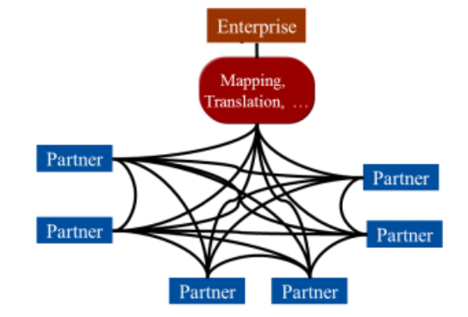
B2B MODELS
The graphic below illustrates the direct B2B scenario.
This model is sometimes called the ―spaghetti model, or the ―spider model‖ because of its complexity

Slide 31
B2B MODELS
Network Model
To avoid the complexity of the direct model, many companies decide to work exclusively through a B2B Service Provider, which, in the days prior to the internet, was referred to as a Value-Added Network (VAN).
In this model, you have a single connection to the Service Provider using whatever protocol you prefer – e.g. AS2, SFTP, FTPS, FTP over VPN, RosettaNet
Likewise, your trading partners connect to the Service Provider, each selecting the connectivity protocol that best meets its company‘s requirements.
The Service Provider facilitates the exchange of electronic documents via its network.
The graphic below illustrates the network model of B2B.

Slide 32
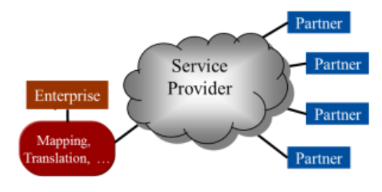
B2B MODELS

Slide 33
B2B MODELS
Hybrid Model
The hybrid approach to B2B is a combination of the direct and network models
Businesses will connect directly via the internet to their trading partners with whom they do the highest volume of transactions, using one or two preferred protocols, in order to save on Service Provider transaction fees ‘
For large communities, the hybrid model is much more commonly used today
The graphic below illustrates the hybrid model of B2B

Slide 34
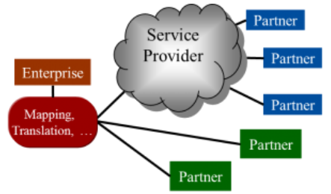
B2B MODELS

Slide 35
B2B MODELS
Managed Model
In the managed model, the business outsources the entire B2B process to an external Service
Provider.
This greatly reduces resource requirements, expenses and complexity
The Service Provider receives your business documents directly from your ERP system (SAP, Oracle, etc.) and then assumes responsibility for all the mapping, translation, technical support, data center operations and document tracking
Once documents are ready for delivery to your trading partners, the service provider delivers them either directly to the partners or via the network, depending on the individual trading partner requirements.
The graphic below illustrates the managed model.

Slide 36
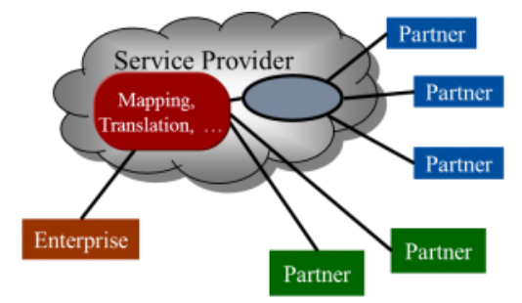
B2B MODELS (Managed Model )

Slide 37
Discussion
What role does weather play in e-commerce operations?
https://www.linkedin.com/pulse/what-role-does-weather-play-e-commerce-operations-ulrich-thonemann/

